Slide 1
STAT 50 Section 2.1 Basic Ideas
02/04/2021

Slide 2
































Slide 3
















































Slide 4

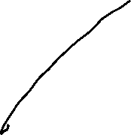






















Slide 5



























































Slide 6













Slide 7





























































Slide 8


































Slide 9




















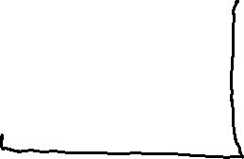





Slide 10




















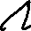







Slide 11













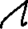





























Slide 12

































Slide 13











































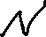



Slide 14




























Slide 15


















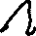









Slide 16




















Slide 17

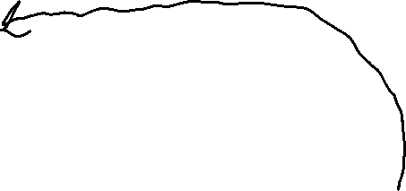










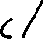

















Slide 18





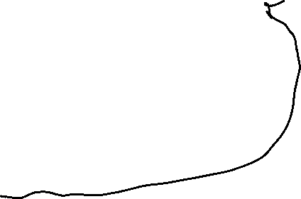


























Slide 19

























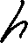






Slide 20




















Slide 21




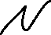





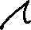



Slide 22





















